Slide 1

चरैवेति, चरैवेति
Keep progressing to attain a higher self.
avinash.bhagat@lpu.co.in Avinash Bhagat 9463281930

Slide 2
CAP275: Data Communication and Networking
Lecture # 9
Physical Layer-1
avinash.bhagat@lpu.co.in Avinash Bhagat 9463281930

Slide 3
Physical Layer
Concerned with transmission of raw bits over a communication channel.
Number of pins and functions of each pin of the network connector.
Signal level, data rate (electrical)
Direction of data transmissions
Establishing or breaking connection
Deals with physical transmission medium.

Slide 4
Physical Layer
Physical characteristics of interface and medium.
Representation of bits.
Data rate and duration of bits.
Synchronization of sender and receiver clock.
Line configuration—point to point or multipoint.
Physical topology
Transmission mode.– simplex or duplex

Slide 5
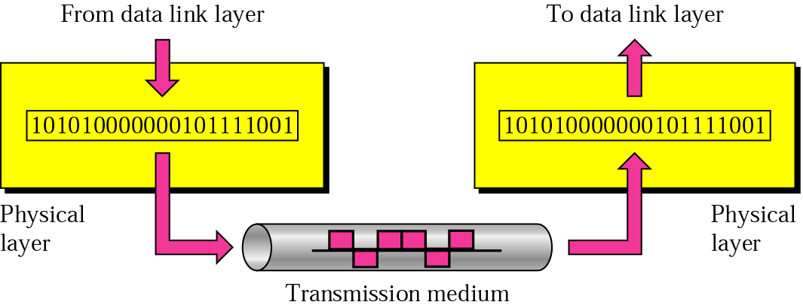

Slide 6
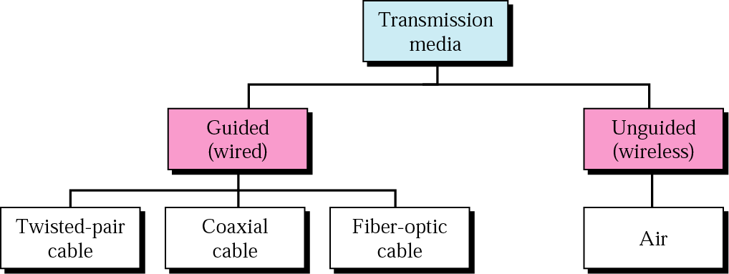

Slide 7
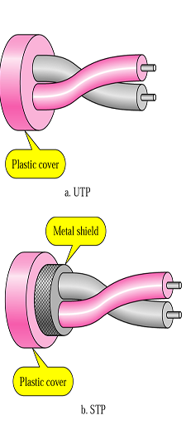
Guided Media Twisted pair
A twisted pair consists of two insulated copper wire arranged in a regular spiral pattern.

Slide 8
Why twisting is required?
Twisting decreases the cross talk interference between adjacent pairs in a cable.
  We pack a large number of pairs together. The signal passing in one pair of wire will induce signal in other pair of wires.
  Tighter twisting provides much better performance, but also increases the cost.

Slide 9
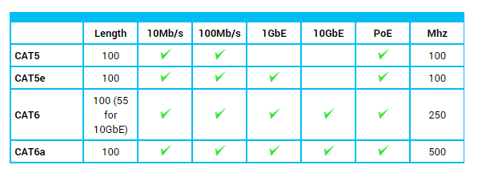

Slide 10
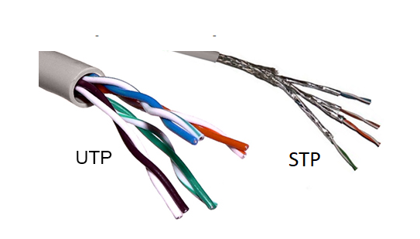

Slide 11
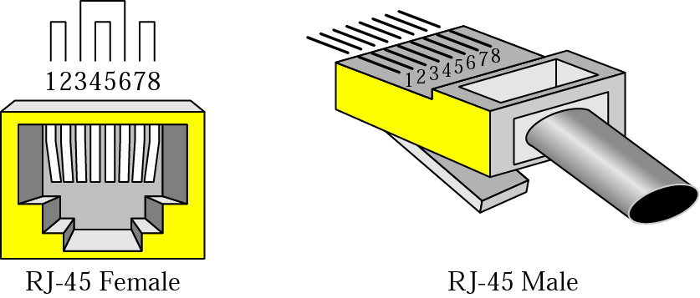
Figure 7.5 UTP connector

Slide 12
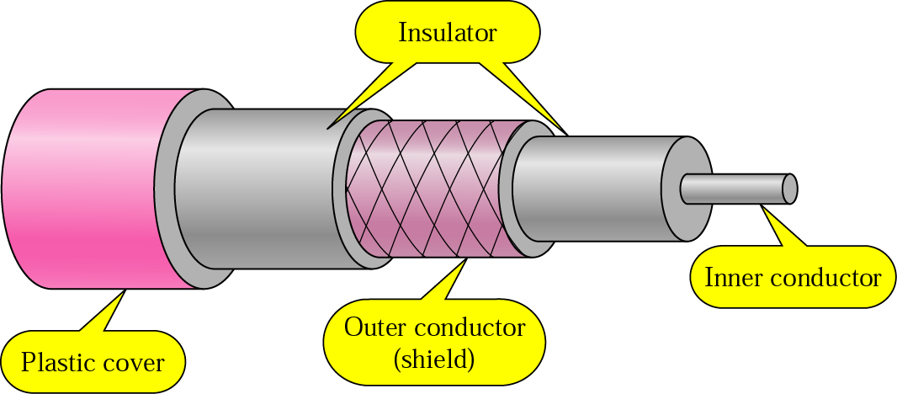
Guided Media Coaxial cable
Consists of a hollow outer cylindrical conductor that surrounds a single inner wire conductor.

Slide 13
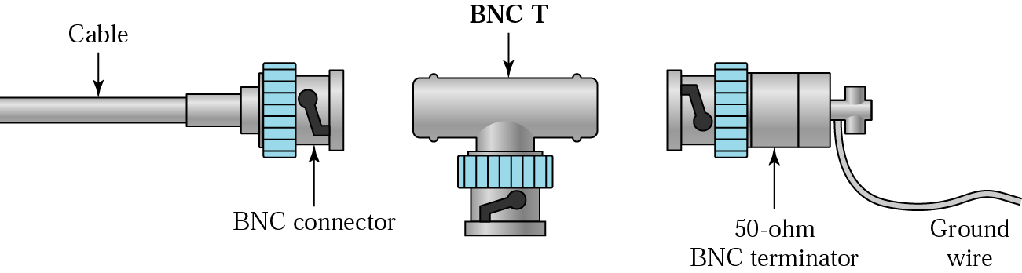
Guided media Coaxial cable
Due to its shielding coaxial cables are much less susceptible to interference or crosstalk than twisted pair.
Bayonet Neill Concelman connector is used.

Slide 14
Applications of Coaxial Cable
Television distribution as BW is high
Long distance telephone transmission (10,000 voice channels per cable simultaneously because of higher BW)
LAN

Slide 15
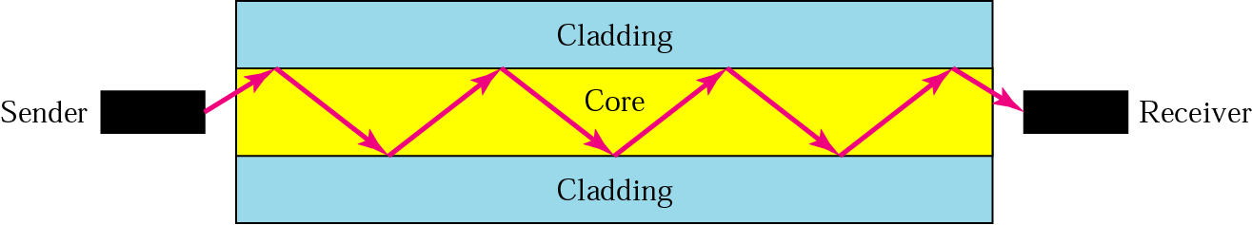
Guided Media Optical Fiber
An optical fiber is a thin (2 to 125 micrometer), flexible medium capable of conducting an optical ray.
It is made of ultra pure fused silica, glass fiber or even plastic
It has a cylindrical shape and consists of three concentric sections
      Core
      Cladding
      jacket
https://www.youtube.com/watch?v=rS-zUcAOFd0
Notes:
The core consists of one very thin strands of fibers made of glass or plastic.
The cladding is a glass or plastic coating that has optical properties different from the core
The jacket surrounds one or a buddle of cladded fibers.

Slide 16
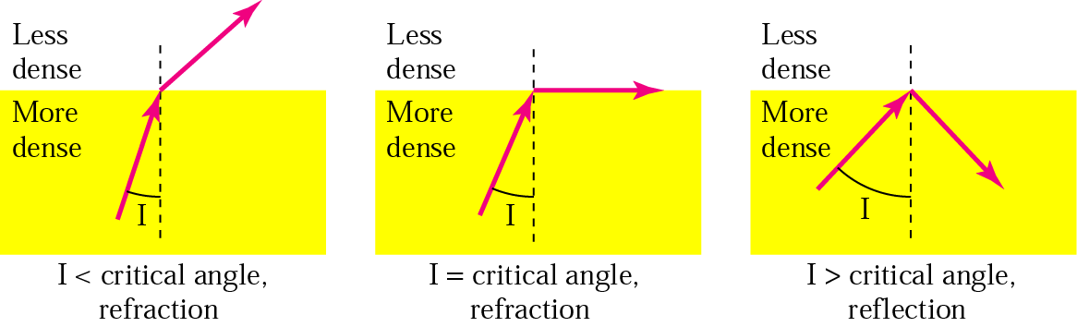
Guided Media Optical Fiber

Slide 17
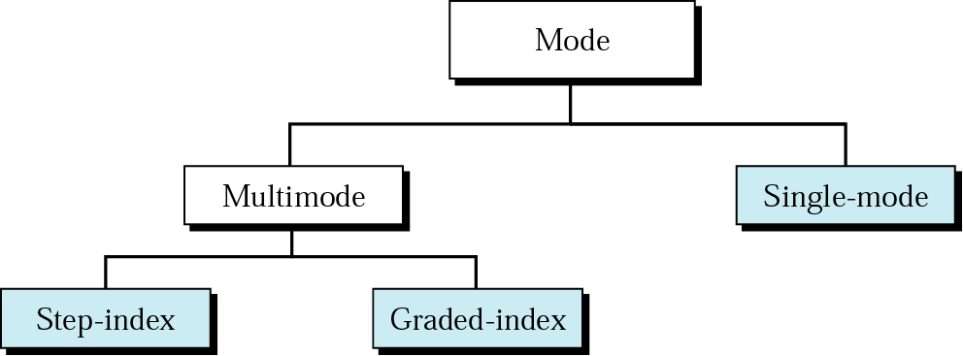

Slide 18
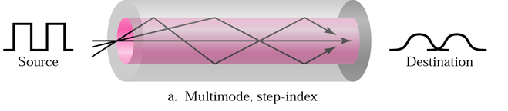
Classification of Optical Fiber
Multiple Mode Step Index:
Refers to the variety of angles that will reflect. Multiple propagation path exists, signal elements spread out in time and hence the data rate

Slide 19
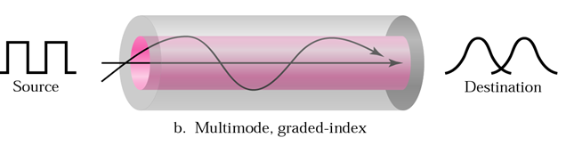
Classification of Optical Fiber
Multiple Mode Graded Index:
By varying the refractive index of the core, rays may be focused more efficiently than multimode.

Slide 20
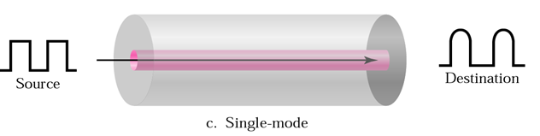
Classification of Optical Fiber
Single Mode:
When fiber core radius is reduced, fewer angles will reflect By reducing the radius of the core to the order of a wavelength, only a single angle or mode can pass – the axial ray.

Slide 21
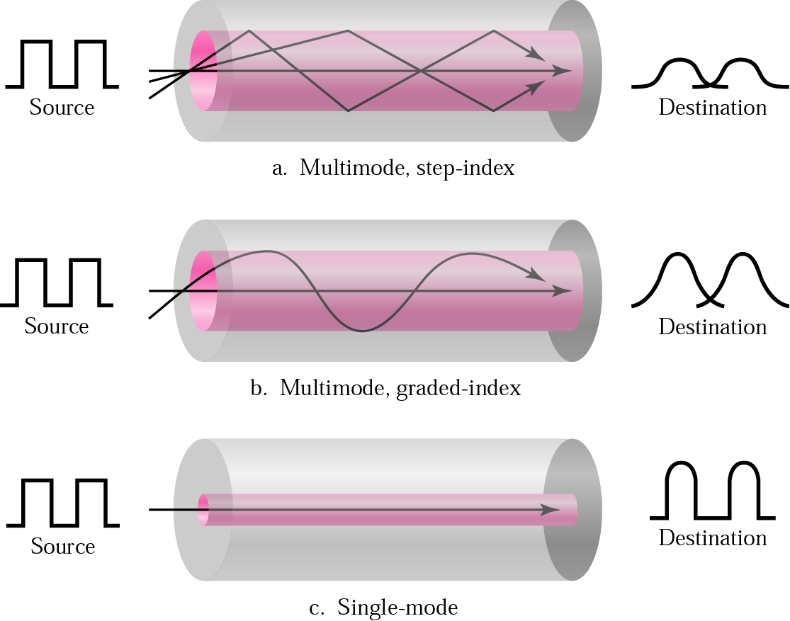

Slide 22
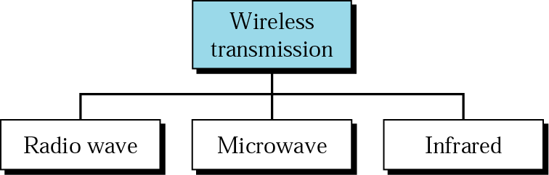
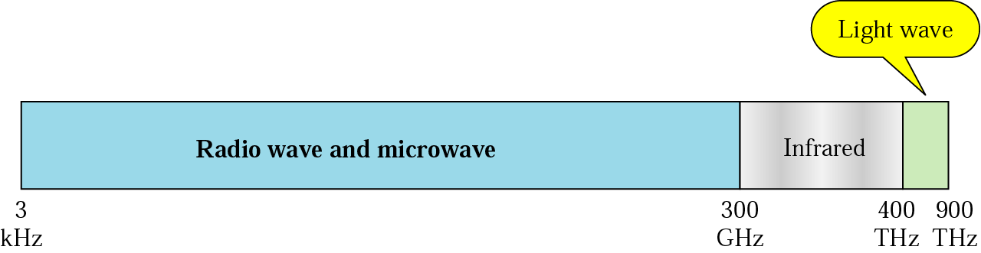
Wireless communication
Broadly EM spectrum can be divided into three parts

Slide 23
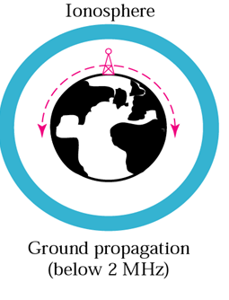
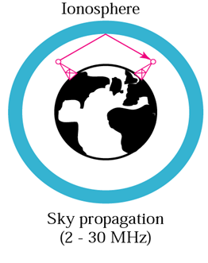
Propagation methods
Ground Propagation:
Below 2MHz
Communication propagate in all the direction around the earth
Sky propagation:
Between 2 to 30 MHz
EM Signal from the transmitter will go to the ionosphere layer and will bounce back.
Signals can be send to very large distance

Slide 24
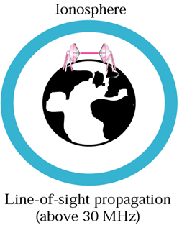
Propagation methods
Line of sight Propagation:
Above 30 MHz
Above 30 MHz the frequency is very high bandwidth is small and the wave acts as light wave, signal gets abstracted when there is any building in between.
Terrestrial Microwave, Satellite communication.

Slide 25
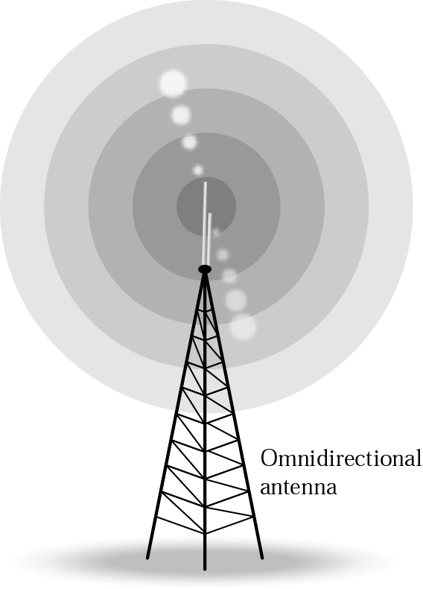
Radio waves
Frequency range- 30 MHz to 1 GHz
Omnidirectional in nature.
Can penetrate walls
Less sensitive to rainfall
Not Suitable for line of sight communication.

Slide 26
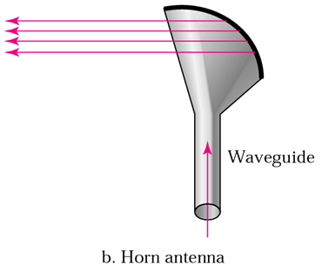
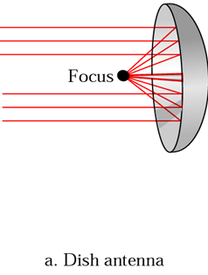
Microwaves
Frequency range 2GHz to 4 GHz
Highly Directional.
Suitable for point to point transmission

Slide 27
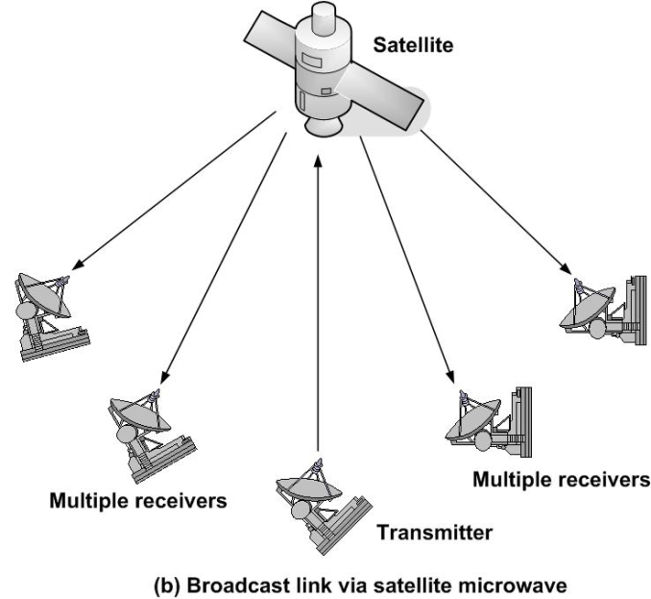
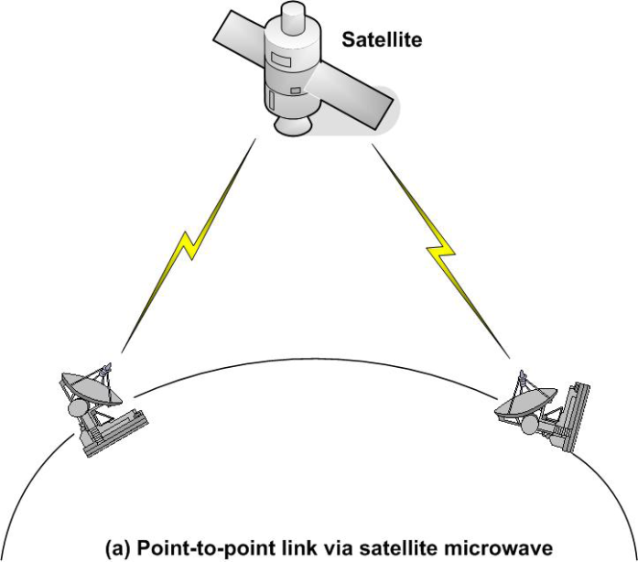
Satellite Communication
A communication satellite is basically a microwave relay station.
Used to link two or more earth stations.
Satellite communication configurations:
  Point to point configuration
  Broadcast configuration

Slide 28
Satellite Communication
Geostationary Orbit
  To keep a satellite stationary
  Height of 35784 km
Three satellite can cover the entire earth
To avoid interference
  6/4 GHz (5.9-6.4 / 3.7-4.2band.) C Band
  14/12 GHz ( 11.7-12.2 / 14.0-14.5)band. Ku
  28/18 GHz (27.7-31.0 / 17.7- 21.0 ) band Ka Band

Slide 29
Review Questions
Q1 On what parameters the quality of transmission depends in case of guided transmission media?
Q-2. Why wires are twisted in case of twisted pair of transmission medium?
Q-3. Give a popular example where co-axial cables are used for broadband signaling.
Q-4. What is crosstalk? How is it minimized in case of twisted-pair of wire?
Q5 What are the key functions of a physical layer?
Q-6. Write a note on optical fiber cable / coaxial cable/ twisted pair cable?
Q7 Write a note on satellite communication.
Q8 Write a note on various sky, ground and line of site propagation methods.

Slide 30
Multiple Choice Questions
The _______ layer changes bits into electromagnetic signals.
a. Physical
b. Data link
c. Transport
d. None of the above
Which of the following is an application layer service?
a. Remote log-in
b. File transfer and access
c. Mail service
d. All the above
Why was the OSI model developed?
a. Manufacturers disliked the TCP/IP protocol suite.
b. The rate of data transfer was increasing exponentially
c. Standards were needed to allow any two systems to communicate
d. None of the above

Slide 31
Multiple Choice Questions
Multiple Choice Questions
The _______ layer changes bits into electromagnetic signals.
a. Physical
b. Data link
c. Transport
d. None of the above
Which of the following is an application layer service?
a. Remote log-in
b. File transfer and access
c. Mail service
d. All the above
Why was the OSI model developed?
a. Manufacturers disliked the TCP/IP protocol suite.
b. The rate of data transfer was increasing exponentially
c. Standards were needed to allow any two systems to communicate
d. None of the above

Slide 32
Multiple Choice Questions
The _______ model shows how the network functions of a computer ought to be organized.
a. CCITT
b. OSI
c. ISO
d. ANSI
The physical layer is concerned with the movement of _______ over the physical medium.
a. programs
b. dialogs
c. protocols
d. bits

Slide 33
Multiple Choice Questions
The _______ model shows how the network functions of a computer ought to be organized.
a. CCITT
b. OSI
c. ISO
d. ANSI
The physical layer is concerned with the movement of _______ over the physical medium.
a. programs
b. dialogs
c. protocols
d. bits

Slide 34
Multiple Choice Questions
Multiple Choice Questions
In the OSI model, what is the main function of the transport layer?
a. node-to-node delivery
b. process-to-process message delivery
c. synchronization
d. updating and maintenance of routing tables
In the OSI model, encryption and decryption are functions of the ________ layer.
a. transport
b. session
c. presentation
d. application
When a host on network A sends a message to a host on network B, which address does the router look at?
a. port
b. logical
c. physical
d. none of the above

Slide 35
Multiple Choice Questions
In the OSI model, what is the main function of the transport layer?
a. node-to-node delivery
b. process-to-process message delivery
c. synchronization
d. updating and maintenance of routing tables
In the OSI model, encryption and decryption are functions of the ________ layer.
a. transport
b. session
c. presentation
d. application
When a host on network A sends a message to a host on network B, which address does the router look at?
a. port
b. logical
c. physical
d. none of the above

Slide 36
Multiple Choice Questions
To deliver a message to the correct application program running on a host, the _______ address must be consulted.
a. port
b. IP
c. physical
d. none of the above
IPv6 has _______ -bit addresses.
a. 32
b. 64
c. 128
d. variable

Slide 37
Multiple Choice Questions
To deliver a message to the correct application program running on a host, the _______ address must be consulted.
a. port
b. IP
c. physical
d. none of the above
IPv6 has _______ -bit addresses.
a. 32
b. 64
c. 128
d. variable

Slide 38
Multiple Choice Questions
The ______ layer is responsible for moving frames from one hop (node) to the next.
a. physical
b. data link
c. transport
d. none of the above
The ______ layer adds a header to the packet coming from the upper layer that includes the logical addresses of the sender and receiver.
a. physical
b. data link
c. network
d. none of the above

Slide 39
Multiple Choice Questions
The ______ layer is responsible for moving frames from one hop (node) to the next.
a. physical
b. data link
c. transport
d. none of the above
The ______ layer adds a header to the packet coming from the upper layer that includes the logical addresses of the sender and receiver.
a. physical
b. data link
c. network
d. none of the above

Slide 40
Multiple Choice Questions
Multiple Choice Questions
The_________ layer is responsible for the delivery of a message from one process to another.
a. physical
b. transport
c. network
d. none of the above
The ________ address, also known as the link address, is the address of a node as defined by its LAN or WAN.
a. port
b. physical
c. logical
d. none of the above

Slide 41
Multiple Choice Questions
The_________ layer is responsible for the delivery of a message from one process to another.
a. physical
b. transport
c. network
d. none of the above
The ________ address, also known as the link address, is the address of a node as defined by its LAN or WAN.
a. port
b. physical
c. logical
d. none of the above

Slide 42
References :
Text Book:
  Behrouz A. Forouzan, Data Communication and networking, 4th Ed., Tata McGraw Hills year of publication 2006
Other Specific Book:
  Andrew S. Tanenbaum,Computer Network 2nd Edition, PHI, Third Edition 1997
  Comer E. Doughlas,Computer Networks and Internets, 2nd Ed., Pearson, 2000
  W. Stallings,Data and Computer Communications, 7th Ed., Pearson, 2002.

Slide 43

See you in next class

